Slide 1

Budgets, Reserves
And
Financially Sustainable Communities
September 9, 2025
Presented by:
Peter B. Miller, RS, EBP

Slide 2
Topics:
Module 1: Importance of Reserves
Module 2: Basic Tenets
Module 3: Financially Sustainable Communities
Module 4: Sample Reserve Study
Module 5: The Board’s Involvement
Module 6: Cash Flow vs. Component
Module 7: Inflation CPI v. PPI

Slide 3
Module 1
The Importance of Reserves

Slide 4
What are Reserves?
Replacement Reserves? Money budgeted each year for the replacement and major repair of common elements.
Replacement Reserve Studies? Financial forecasting report used to assist Boards in establishing appropriate annual Reserve Funding Levels in Budget.

Slide 5
Why are Reserves Important?
Adequate Reserves help to Protect, Preserve and Enhance the property values in your community.

Slide 6
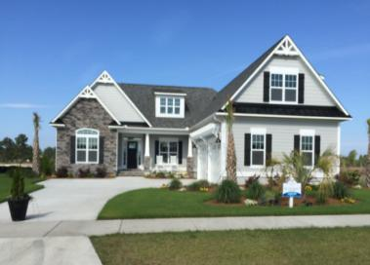
“Perhaps the greatest
Duty of the Board of
Directors is to Protect,
Preserve and Enhance
the value of the homes
within the community!”
Robert Lyles, Esq. Charleston, SC

Slide 7
How Do Reserves protect property values?
Ensure that funding is available for timely replacement.
Stabilize Annual Assessment.
Spread replacement costs equitably over time.

Slide 8
Is the Board Required to do a Reserve Study?
Not all States require Reserve Studies.
Governing Docs. may provide Board the authority to establish Reserves in budget.
Boards still have a Fiduciary Duty to make prudent, business-like decisions.
Maintaining Reserves is considered Industry “Best-Practice” and “Industry Standard”.

Slide 9
Reserve Study Levels
Level I
  Full Study w/ Onsite Condition Assessment.
Level II
  Reserve Study Update w/ On-site Condition Assessment
Level III
  Reserve Study Update w/o On-site Condition
  Assessment
Level IV
  Preliminary Reserve Study (from Drawings)

Slide 10
What are Reserve Components
Commonly-Owned Physical Asset (check governing documents)
Will require major repair or replacement
Suggested Resolution of the Board:
  Normal Economic Life > 3 Years
  Replacement Cost > $X,XXX

Slide 11
National Reserve Study Standards as Revised 2023
Must update every three years.
Must include funding for major maintenance.
Must include funding for periodic Structural Evaluations. *
* For some types of buildings.

Slide 12
Engaging a Qualified Reserve Study Provider
Designated Reserve Specialists (RS).
Flexible with revisions and Zoom mtgs.
DO NOT SELECT BASED UPON LOW BID! There is a difference between cost and value!
Board should read Sample Report!
Provides Cash Flow Method of Calculation*.
  *More realistic method of calculating Reserves.

Slide 13
Why We Plan For Reserves
Legal
Practical/Financial
Ethical

Slide 14
Legal Considerations
State Statutes
Governing Documents
IRS Guidelines
Bank Loan Requirements
Fiduciary Duty of Board
Freddie/Fannie Requirements

Slide 15
Practical / Financial
Considerations
PROTECT PROPERTY VALUES!
Sound Financial Planning!
10% - 50% of Annual Budget!
Avoid Special Assessments!
Equitable Distribution of costs over time!

Slide 16
Ethical Considerations
Avoids “kicking the can down the road” (future financial obligations) to future or long-term owners!
Equitable Distribution of costs over time! “Everybody pays their fair share!” *
*Not an easy sell among some demographics!

Slide 18
Module 2
Three Basic Tenets of a
Reserve Study

Slide 19
Tenet #1:
The Reserve Study must be readable and understandable in order to be usable!

Slide 20
Tenet #2:
The Reserve Study must reflect the priorities, the plans, the hopes, and the aspirations of the community!

Slide 21
Tenet #3
The Reserve Study funding recommendation must be practical and implementable!

Slide 22
Reasonable Expectations!
A Reserve Study is a visual condition assessment.
It is not an in-depth technical study or structural evaluation.
Increase the accuracy of the Study by bringing in your professional experts! i.e., HVAC, Bathymetry, Paving, etc.

Slide 24
Module 3
Financially Sustainable Communities

Slide 25
Where do the Reserves fit in the budgeting process?
Maintenance & Operations
Reserves

Slide 26
Three distinct purposes
Operations
Maintenance
Reserves

Slide 27
Operations Costs
Costs related to operating the “Corporation”
Utilities
Management Fees
Personnel
Taxes
Consultants
  Attorneys
  Accountants
  Architects
  Engineers
  Etc.

Slide 28
Maintenance Costs
All costs associated with maintaining the “Brick and Mortar” aspects of the “Corporation”.

Slide 29
Replacement Reserve Costs
Funds set aside as part of the annual budget for the major repair and replacement of the commonly-owned components of the community.

Slide 30
Financially Sustainable Community!
Operations
Maintenance
Reserves

Slide 32
Module 4
Sample
Reserve Study

Slide 33
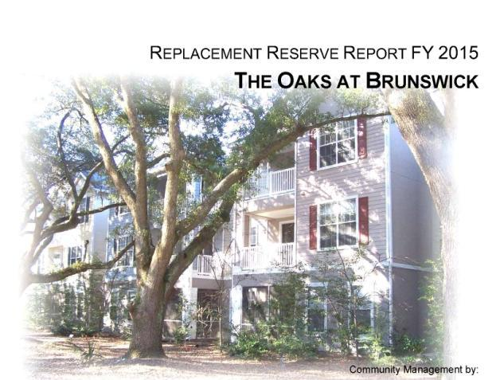

Slide 34
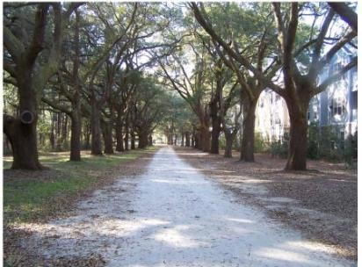

Slide 35
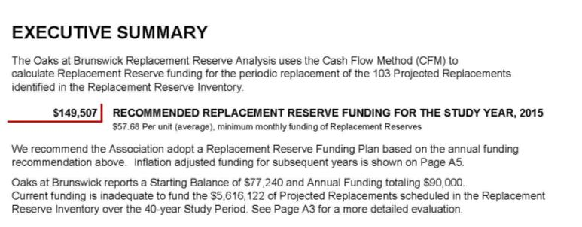
Starting Balance $77,240
Current Funding $90,000
Recommended Funding $150,000

Slide 36
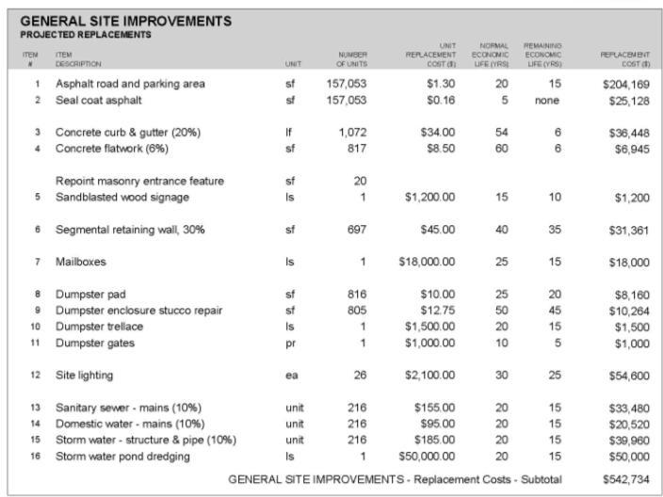

Slide 37
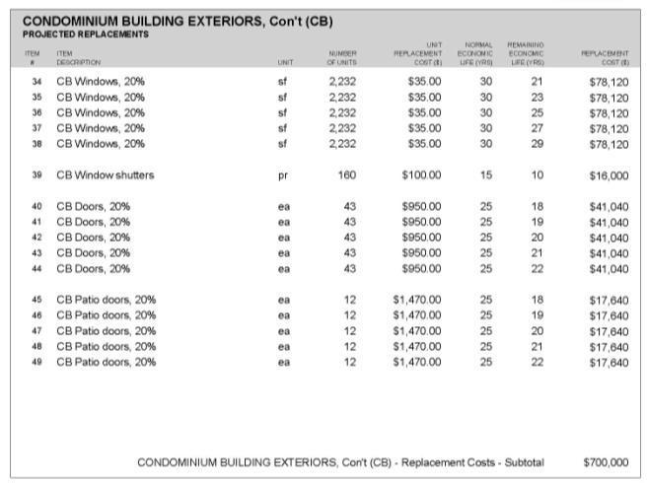

Slide 38
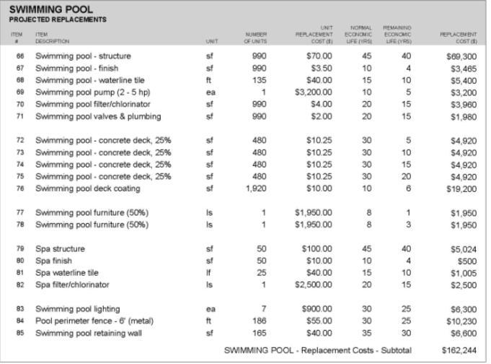

Slide 39
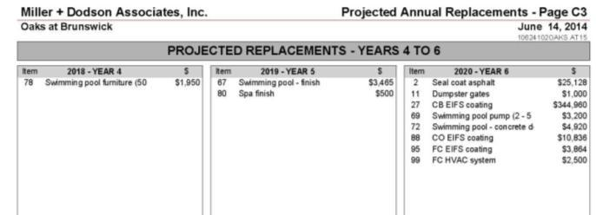
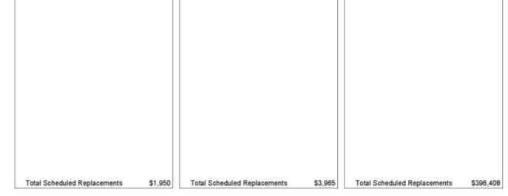

Slide 40
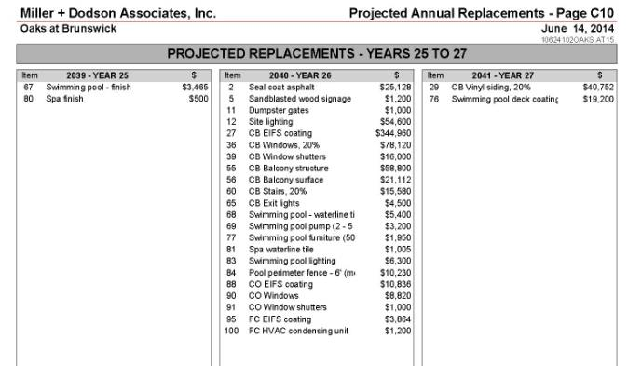


Slide 41
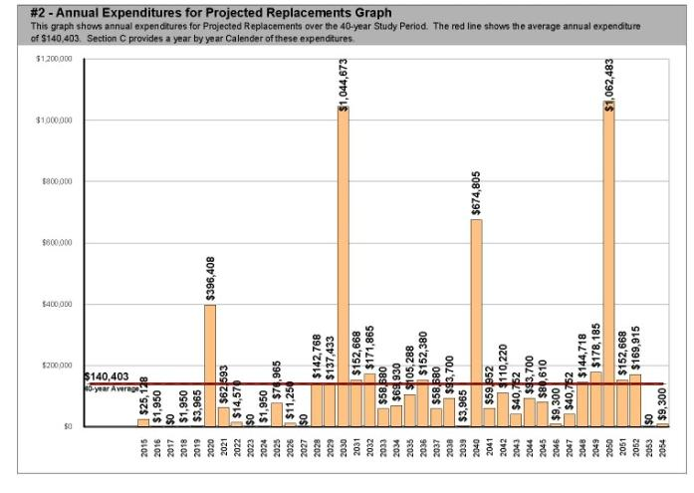
Projected Annual Expenditures are show by individual year in this bar graph.

Slide 42
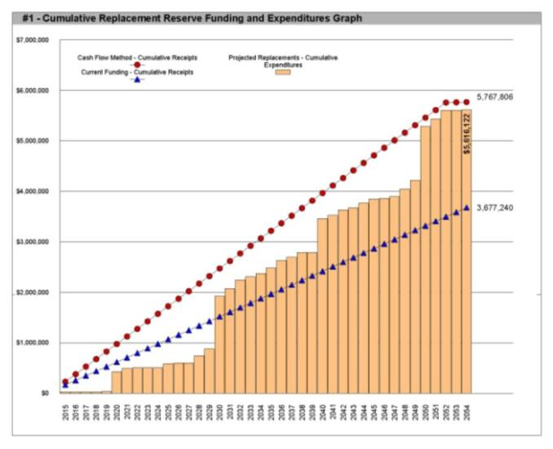
Cash Flow
$150,000
Current Funding
$90,000
Cumulative totals of Annual Expenditures shown in this graph. See page A1 and A4

Slide 44
Module 5
The Board’s Involvement

Slide 45
Board Involvement
Establish inventory.
Set threshold policy: (Board Resolution)
  Lasts longer than “X”
  Costs more than “Y”
Provide data, guidance, contractor names, and historical context.
Set Minimum Fund Balance.

Slide 46
Board Involvement (continued)
Review draft:
  Provide priorities and other input.
  Replacement timing, replacement costs, etc.
Investigate alternatives.
Develop Strategic Funding Plan.

Slide 47
6%

Slide 48
100%
100%
100%

Slide 50
Cash Flow
$150,000
Current Funding
$90,000

Slide 51
What’s the Next Step?
You as the Manager…
You as a Board Member…
You as a Finance Committee Member…

Slide 52
What’s the Next Step?
You just were handed this report!
It says to increase the Reserve Funding from $90K to $150K!
What?
That’s a $60K annual increase!
Holy Cr@p!

Slide 53
What Are Your Alternatives?
Increase Normal Assessments
Special Assessment
Commercial Bank Loan
Combination of two or more

Slide 54
Next Step:
Review inventory data.
Re-think replacement priorities.
Check Cash Flow margins.
Develop Strategic Funding Plan.

Slide 55
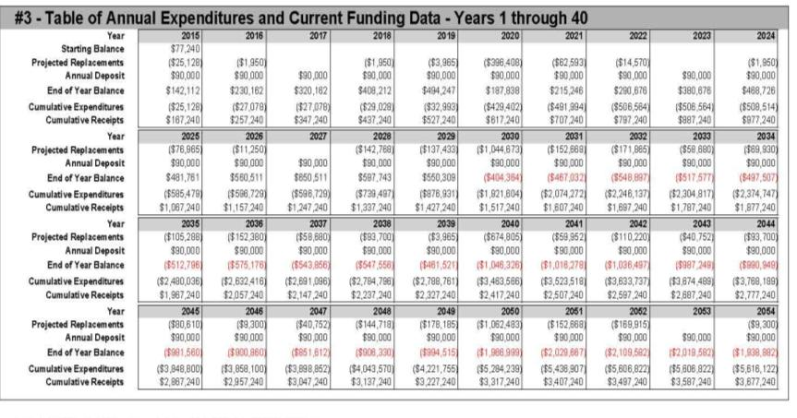
Check Cash Flow Margins
Year end balance stays positive until year 2030.

Slide 56
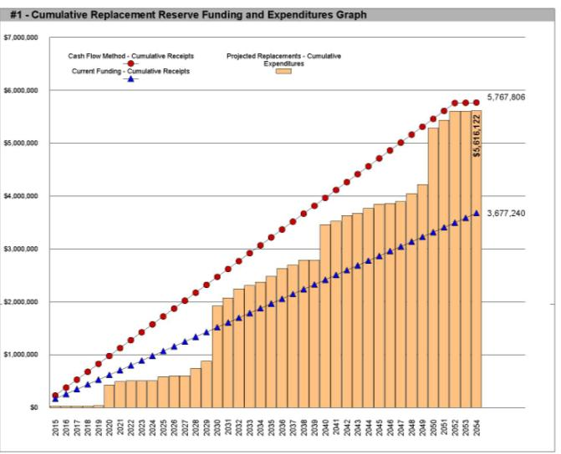
This association has the latitude to “ramp up” rather than have one large increase.

Slide 57
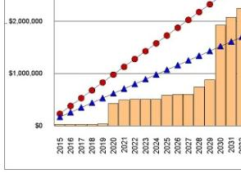
Cash Flow - $150,000
Current Funding - $90,000

Slide 58
Strategic Funding Plan
Ramp Up Annual Funding over five years:
Year 1: $90K to $102K
Year 2: $102K to $114K
Year 3: $114K to $126K
Year 4: $126K to $138K
Year 5: $138K to $150K *
*Year 5 would bring Reserve Study update and would adjust for inflation, underfunding, changed conditions.

Slide 60
Module 6
Cash Flow Method
Versus
Component Method

Slide 61
CASH FLOW VS COMPONENT
(Pooling vs. Full Funding)
CASH FLOW (“Pooling”) METHOD
  Treats Reserves as an aggregate “pool” of funds to adequately fund each year.
COMPONENT (“Full Funding”) METHOD
  Treats each Reserve Item as a separate “line item” budget to adequately fund each item.

Slide 62
Illustration of the Different Mathematical Models
One Project per year,
Projects repeat every 4 yrs
Cost of $12,000 per Project
Four Projects:
  Year One - Parging,
  Year Two - Seal Coat,
  Year Three - Plumbing,
  Year Four - Retaining Wall
(Assume $Zero Starting Balance) (Assume $Zero Threshold)

Slide 63
Cash Flow Calculations
 | Year | 1st | 2nd | 3rd | 4th | Total
COMPONENT | Cost x $1,000 | Annual Contributions
Parging Year One | $12 | 3 | 3 | 3 | 3 | $12
Paving Year Two | $12 | 3 | 3 | 3 | 3 | $12
Plumbing Year Three | $12 | 3 | 3 | 3 | 3 | $12
Retaining Wall Year Four | $12 | 3 | 3 | 3 | 3 | $12
Total Cost | $48 | $12 | $12 | $12 | $12 | $48

Slide 64
Component Calculations
 | Year | 1st | 2nd | 3rd | 4th | Total
COMPONENT | Cost x $1,000 | Annual Contributions
Parging Year One | $12 | 12 | 3 | 3 | 3 | $21
Paving Year Two | $12 | 6 | 6 | 3 | 3 | $18
Plumbing Year Three | $12 | 4 | 4 | 4 | 3 | $15
Retaining Wall Year Four | $12 | 3 | 3 | 3 | 3 | $12
Total Cost | $48 | $25 | $16 | $13 | $12 | $66

Slide 65
Comparison:
Cash Flow Recommendation: $48K
Component Recommendation: $66K
Component Method requires 38% more funding than Cash Flow.
Cash Flow would be 72% of “Full Funding” if using Component Method.
Copyright @ Miller Dodson Associates 2022

Slide 66
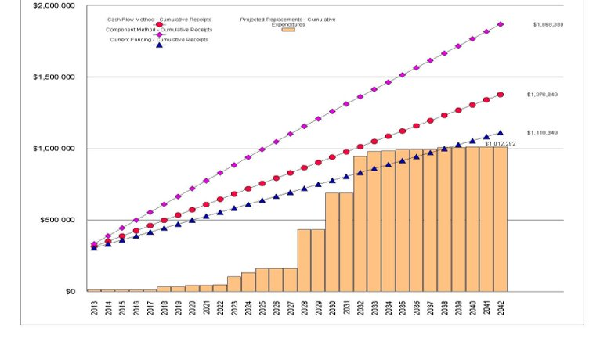
Actual Reserve Study
$56,026
$36,791
$27,768

Slide 68
Module 7
Inflation
and
Reserve Fund Planning

Slide 69
Understand Inflation -
CPI vs PPI
Consumer Price Index (CPI)
  Food Costs
  Fuel Costs
  Electricity Costs
  Housing Costs (meaning rent)
Producer Price Index (PPI)
  Manufacturing costs
  Construction costs

Slide 70
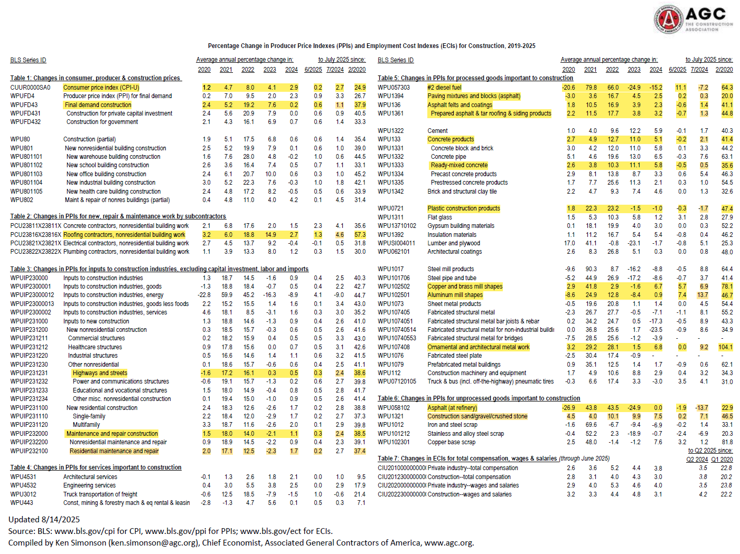

Slide 71
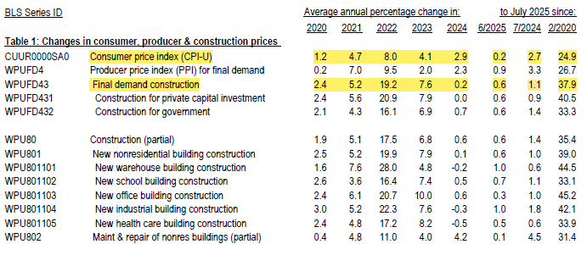

Slide 72


Slide 73
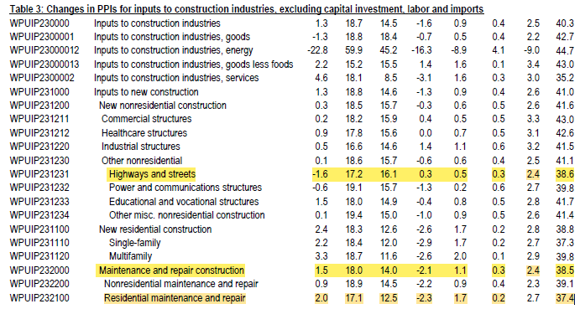

Slide 74
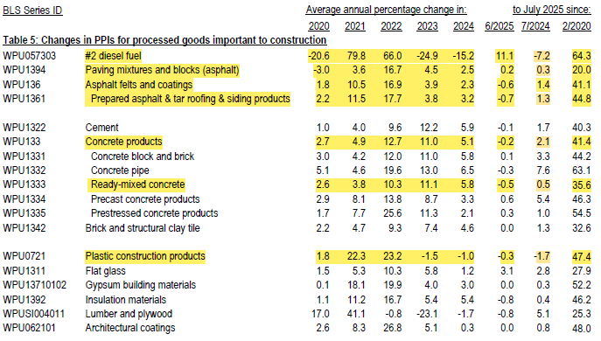

Slide 75
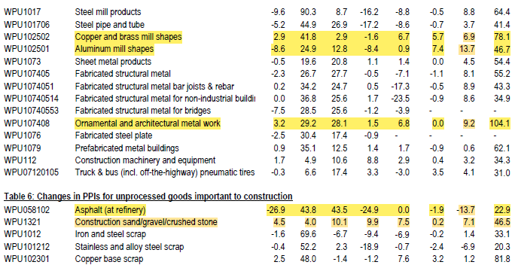

Slide 76
DIVE BRIEF:
Construction DIVE
February 13, 2025
Tariff fears tied to biggest construction cost jump in 2 years.
Contractors have rushed to buy materials before potential tariffs go into effect, pushing prices higher. More hikes could lie ahead, according to construction trade associations.

Slide 77
Dive Brief:
Construction input prices jumped 1.4% in January, marking the largest monthly increase in two years, according to an analysis by Associated Builders and Contractors.
Energy costs drove much of that increase, with crude petroleum, natural gas and unprocessed energy all rising.
However, the price jump also stems from a rush to purchase materials ahead of potential tariffs, said Anirban Basu, ABC chief economist. The cost of inputs to construction now sits 40.5% higher than February 2020, according to the report.

Slide 78
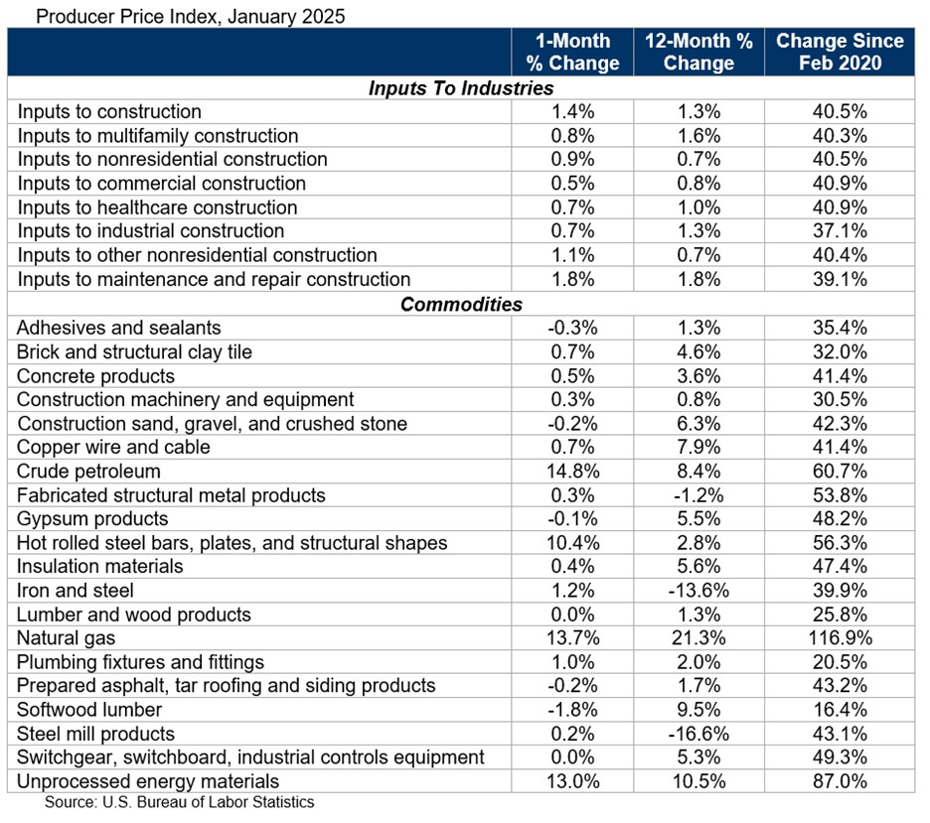

Slide 79
Take Aways
Reserves are necessary to establish a Financially Sustainable Community!
Reserves help protect property values!
Board (and Manager) has an active role in producing an accurate Reserve Study!
Use the Cash Flow Method of calculation!
Inflation is an important consideration in Reserve Planning.

Slide 80
PDF of this presentation is available at
MillerDodson.com

Slide 81
Questions

Slide 82

Speaker Profile
Peter B. Miller, RS, EBP, has worked professionally with community associations, both as an Architect and a Reserve Specialist, for over 35 years. He is one of the most widely recognized authorities in the field of Replacement Reserves and Reserve Fund Planning. A frequent author and speaker, his article “The Reserve Truth – What We Must Learn from the Surfside Florida Tragedy” was published in CAI’s internationally distributed Common Ground magazine.
Peter served on the Community Associations Institute’s (CAI) National Reserve Study Standards Committee that developed the CAI National Reserve Study Standards in the 1990’s and was appointed by CAI’s President a Co-Chair for the “Reserve, Maintenance, and Building Safety Task Force”. Peter served on CAI's National Board of Trustees from 2018 through 2022. Peter has also served as a “Subject Matter Expert” on Reserve Study legislation for the Commonwealth of Virginia, as well as the States of Maryland and Delaware.
The Firm of Miller Dodson Associates specializes in Reserve Studies and conducts between 850 – 1,000 Reserve Studies annually.
Peter and his wife, Kathy, split their time between their award-winning historic home in Annapolis, Maryland and their home in Cape Charles on the lower Eastern Shore of Virginia.

Slide 84
Thank You!

